Slide 1
Wireless Portable Pyrometer
By :
Bhushan Borse
Deepesh Sonigra
Samadnya Kalaskar

Slide 2
CONTENTS
CHAPTER | TITLE | SLIDE NO.
1 | Introduction | 3
2 | Objectives | 5
3 | System Block Diagram | 6
4 | Literature Survey | 7
5 | Description | 10
6 | Working | 12
7 | Component Selection | 13
8 | Schematic Diagram | 17
9 | Expected Results | 19
10 | Methodology | 20
11 | Project Plan | 22
12 | Work Distribution | 23
13 | PCB Layout | 24
14 | Results | 26
15 | Conclusion | 40
16 | Future Scope | 41
17 | References | 42

Slide 3
Introduction
A Pyrometer is suited for the measurement of temperature of objects or any surfaces.
For example, in the foundry industry reliable measurement of the temperature is essential as when the metal cools down it should attain certain temperature to display tensile properties.
The pyrometer makes it possible for foundries to gain new insight into what temperature levels are at the mould or die during the casting process.

Slide 4
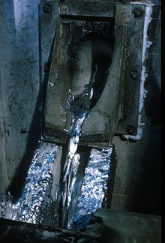

Molten metal before casting
Temperature monitoring required from time to time

Slide 5
Objectives
To design a wireless, portable device which can be used for temperature measurements ranging between 1000º C to 1700ºC.
The device should be battery operated.
There should be Wireless Connectivity to connect to the display.
Facility for calibration settings through user interaction.
The device should display the date and time of the recorded readings.
There should be a storage facility for the set of readings (temperatures) measured by the device.

Slide 6
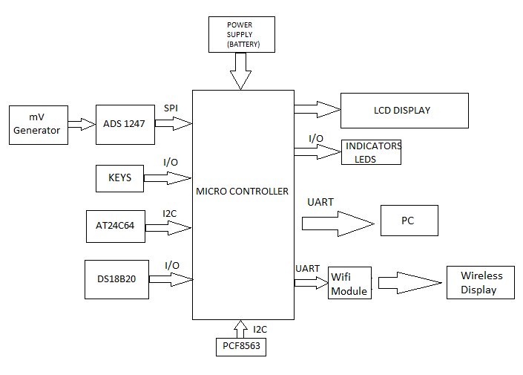
System Block Diagram

Slide 7
Literature survey
We aim to design a device for foundries which require intermittent temperature monitoring. The device should be able to measure the temperature of molten metal which is at 1000º C to 1600ºC.
The in-built Data Logger eliminates human errors in keeping the records.
We achieve this accuracy by using a Sigma Delta ADC instead of the conventional Dual Slope ADC.
Our design uses a microcontroller which belongs to the SMD packaging type. This enables less usage of on circuit space and makes the circuit compact.
Use of a LCD display instead of an LED display saves the power consumption and makes the device battery efficient.

Slide 8
LITERATURE SURVEY
We have focused on making the device portable, it is a handheld unit with a rechargeable battery.
We are providing wireless connectivity between the device and a display with the help of a Wi-Fi module.
The set of measured temperatures along with date and time is stored in EEPROM.
Our product can be easily connected to available data base systems.
It provides automatic recording of the temperature, comprehensive documentation of the temperature readings for up to 2 months.

Slide 9
LITERATURE SURVEY
Parameters | Pyrometers available in market | Wireless portable pyrometer
Companies | Dias, Artech | Our product
Method | Infrared technology and fiber optics. | Based on thermocouple sensing.
Data transfer | To PC | To PC and to wireless display
Accuracy | 1% | Expected - 1%
Display | Battery consuming led | Battery saving lcd display
Operating temperature range | 1000º c to 2000ºc | 1000º c to 1700ºc

Slide 10
DESCRIPTION
Microcontroller
The microcontroller (PIC) is used to do all the logical operations needed and acts as a communication medium between input and output components.
ADC
The output of thermocouple simulator (in mV) is given as an input to ADC. The ADC is used to convert these values to the corresponding count.
Temperature Sensor
The temperature sensor is used for sensing the room temperature. This sensor is used for minimizing the Cold Junction Compensation.
EEPROM
It is used to store the readings along with the date and time of recording. It can store the data for a couple of months.

Slide 11
DESCRIPTION
KEYS
They work as an user interface. They will solve the purpose of navigating through the menu.
LED
They are used to indicate the current status of the device.
RTC
To provide more accurate date and time as compared to the on chip RTC.
Wi-Fi module
It transfers the readings to a remote wireless display. This fulfills the wireless aspects of our device.
Power Supply
Battery charging facility which makes the device portable and enables recharging whenever required.

Slide 12
WORKING
First of all, the thermocouple simulator provides mV readings corresponding to the temperatures ranging between 1000º C to 1600º C.
These readings are given as an input to the ADC. The ADC generates the count which is sent to the microcontroller through SPI.
Further, the temperature value is displayed on a 3.5 LCD display.
The set of readings is saved in the EEPROM through I2C.
The keys can be used to navigate through the menu.
The RTC provides with the date and time update to ensure proper ordered set of readings.
The Wi-Fi module is used to send the readings on a distant wireless display. Wi-Fi module is interfaced via UART.
The LED is used to indicate the current status of the device such as battery level, ready status, measure, complete and error.

Slide 13
COMPONENT SELECTION
ADC SELECTED-ADS1247
Manufacturer and Part No. | MCP3421A0 | MCP3201 | ADS1247 | ADS1248
Resolution (Bits) | 18bit | 10bit | 24bit | 24bit
Sampling Rate | 3.75SPS | 22.3kSPS | 2kSPS | 2kSPS
Supply Voltage Max | 5.5V | 5.5V | 5.5V | 5.5V
ADC / DAC Case Style | SOT-23 | SOT-23 | TSSOP | TSSOP
No. of Pins | 6 Pins | 5 Pins | 20 Pins | 28 pins
Data Interface | I2C | I2C | Serial, SPI | Serial, SPI
Range | Single 8-Bit Sigma-Delta ADCs | Single 10-Bit SAR ADCs | Quad 24-Bit Sigma-Delta ADCs | Octal 24-Bit Sigma-Delta ADCs
Price | Rs.112.76 | Rs.112.76 | Rs.789.64 | Rs.805.12

Slide 14
COMPONENT SELECTION
RTC SELECTED – PCF8563
Parameter | PCF8563 | DS1307
Interface | Via two-line bidirectional I2C-bus. | I2C Serial Interface
Oscillator | On-chip 32.768 kHz oscillator | External 32.768kHz crystal.
Price | Rs. 104.00 | Rs. 235.00

Slide 15
COMPONENT SELECTION
WIFI SELECTED – ESP8266-01
Parameters | ESP 8266 - 01 | ESP 8266 - 02 | ESP 8266 - 05 | ESP 8266 - 12
Form Factor | Small | Small | Medium | Large
Pricing | Rs. 250 | Rs. 340 | Rs. 430 | Rs. 255
ROOM TEMP. SENSOR SELECTED – DS18B20
Parameter | LM92 | DS18B20
Interface | I2CSerial Bus interface | 1-Wire bus
Temp. measurement Range | −25°C to 150°C, | -55°C to +125°C
Accuracy | ±0.5°C for 10°C to 50°C | ±0.5°C for -10°C to +85°C
Price | Rs.656.00 | Rs.360

Slide 16
COMPONENT SELECTION
MICROCONTROLLER – PIC18F65K90
Manufacturer and Part No. | PIC18F65K90 | PIC16F1938 | PIC16F1939
Program Memory Size | 32KB | 28KB | 28KB
RAM Memory Size | 2KB | 1KB | 1KB
EEPROM size | 1024B | 256B | 256B
No. of Pins | 64 | 28 | 40
MCU Case Style | TQFP | SOIC | DIP
No. of I/O's | 53 | 25 | 36
Embedded Interface Type | EUSART, I2C, SPI | EUSART, I2C, SPI | EUSART, I2C, SPI
Supply Voltage Max | 5.5V | 5.5V | 5.5V
Supply Voltage Min | 1.8V | 1.8V | 1.8V
LCD segments | 132 | 60 | 96
Price | Rs.295 | Rs.163.28 | Rs.181.51

Slide 17
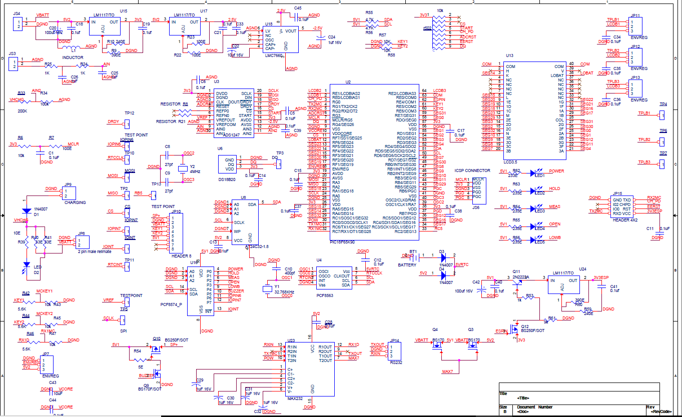
Schematic design

Slide 18
Expected Results
The device should be able to measure the temperature of molten metal which is at 1000º C to 1700ºC.
The required accuracy, resolution and precision should be achieved through meticulous coding and hardware implementation.
The in built Data Logger eliminates human errors in keeping the records.
The collected data should be displayed on a display through the Wi-Fi module and simultaneously saved in the memory.

Slide 19
METHODOLOGY
Hardware requirements
Thermocouple (R type) simulator
Microcontroller
Wi-Fi module
LCD
ADC
Reference room temp. sensor
RTC

Slide 20
METHODOLOGY
Software requirements
IDE
Power Pad
ORCAD Solutions
Logic Port – logic analyzer
Hi-Tech Compiler
Esplorer- Wi-Fi module

Slide 21
PROJECT PLAN
MONTH | TASK
MONTH | TASK
June | Topic Selection
July | Literature Survey
August | Specification document, Block Diagram and Component Selection
September | Schematic Entry (ORCAD)
October | Art Work Layout, (2 weeks) SPI coding, I2C bit banging
November | Microcontroller coding
December | Software testing
January | PCB layout ready (6 weeks)
February | Component placement, PCB soldering
March | UART testing, ADC stability check, LCD, Keypad testing and coding
April | Wi-Fi module coding
May | Unit Testing for final product
June | Final Project Report

Slide 22
WORK DISTRIBUTION
MONTH | Bhushan | Deepesh | Samadnya
June | Requirement gathering, Literature survey | Requirement gathering, Literature survey | Requirement gathering, Literature survey
July | Comparative study for component selection | Specification requirements, memory, accuracy calculations | Comparative study for component selection
August | Block Diagram | Block Diagram | Block Diagram
September | Power supply design, battery charging circuit, selection of Wi-Fi module | I2C, SPI,UART interface distribution, compatibility calculations | LCD segment allocation, Project Report and Documentation
October | Timer coding | Schematic design | Schematic design
November | Netlist correction, Footprint allocation | Art work layout | I2C coding, UART coding
December | PCB Layout check | Microcontroller start up code, SPI coding | PCB Layout check
January | PCB soldering | UART coding | PCB soldering
February | Unit Testing | ADC coding | Unit testing
March | Interrupt based timer coding | LCD coding | I2C coding
April | Unit Testing | Temperature calculation coding Wi-Fi Coding | Temperature calculation coding
May | Unit Testing | Unit Testing | Unit Testing

Slide 23
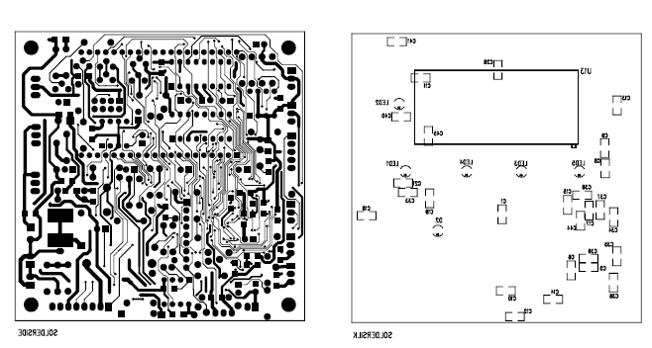
PCB LAYOUT

Slide 24
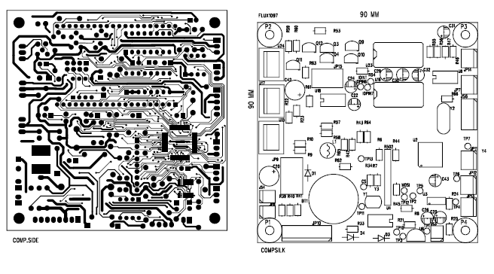
PCB LAYOUT

Slide 25
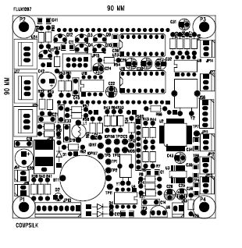
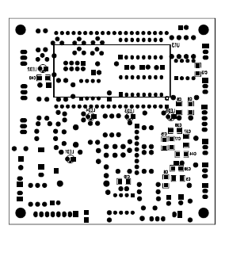
PCB LAYOUT

Slide 26
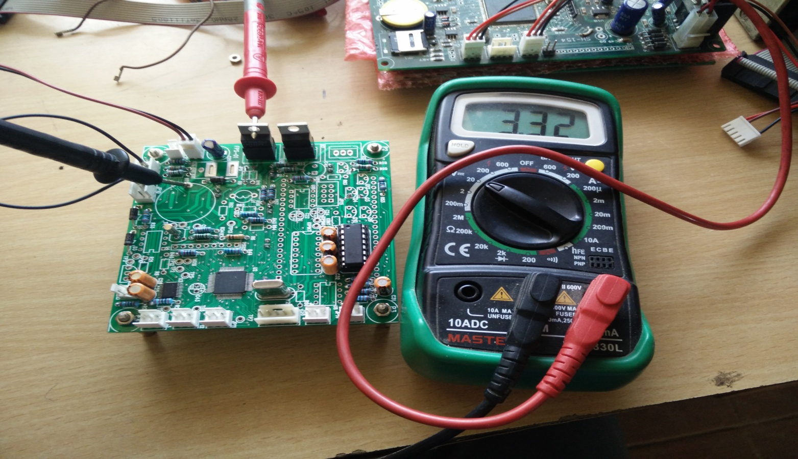
POWER SUPPLY TESTING

Slide 27
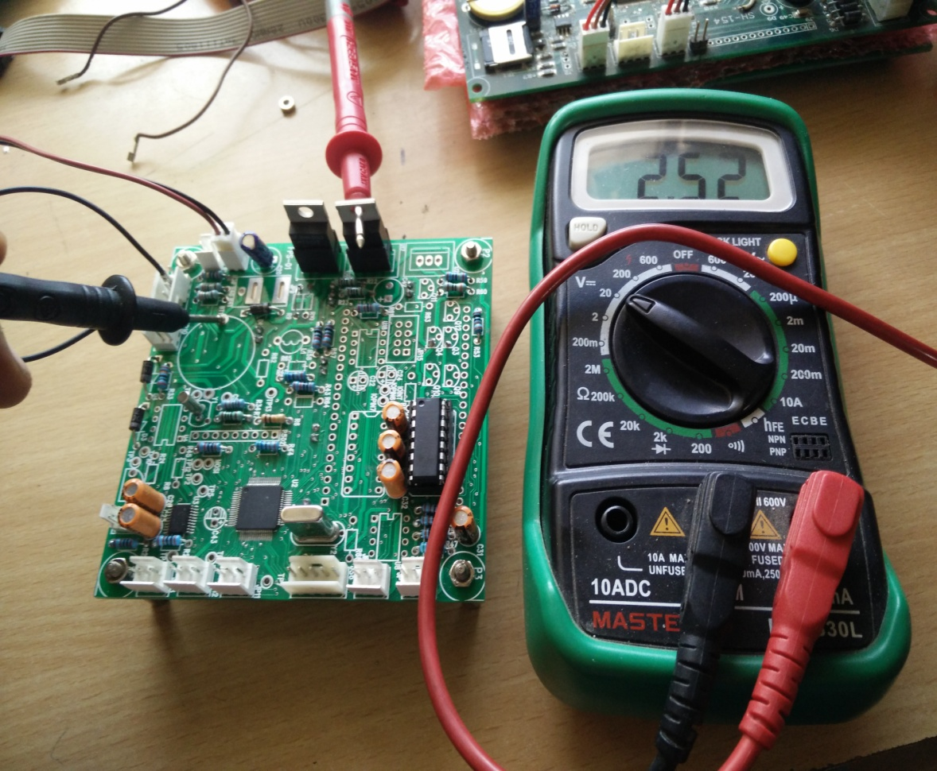
Power supply test for 2.5 V

Slide 28
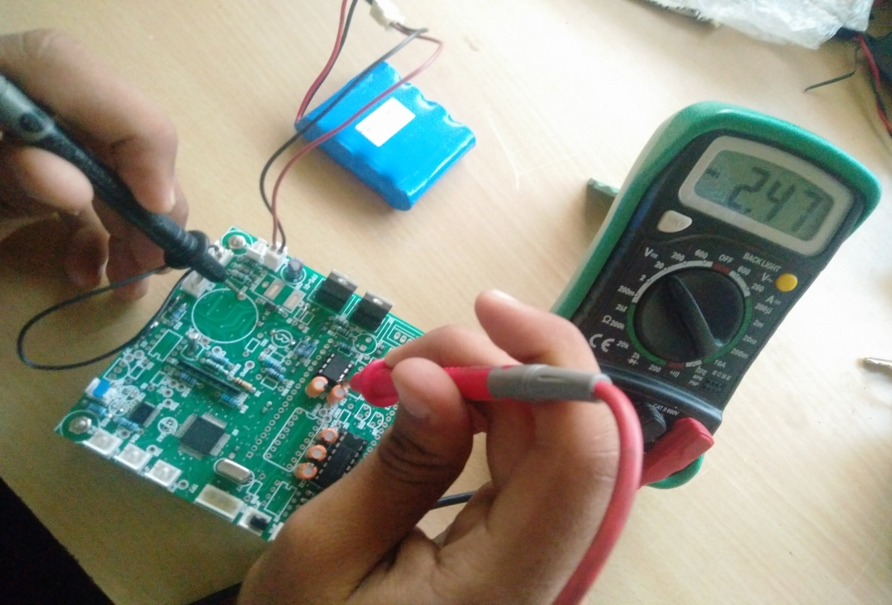
Power supply test for -2.5 V

Slide 29
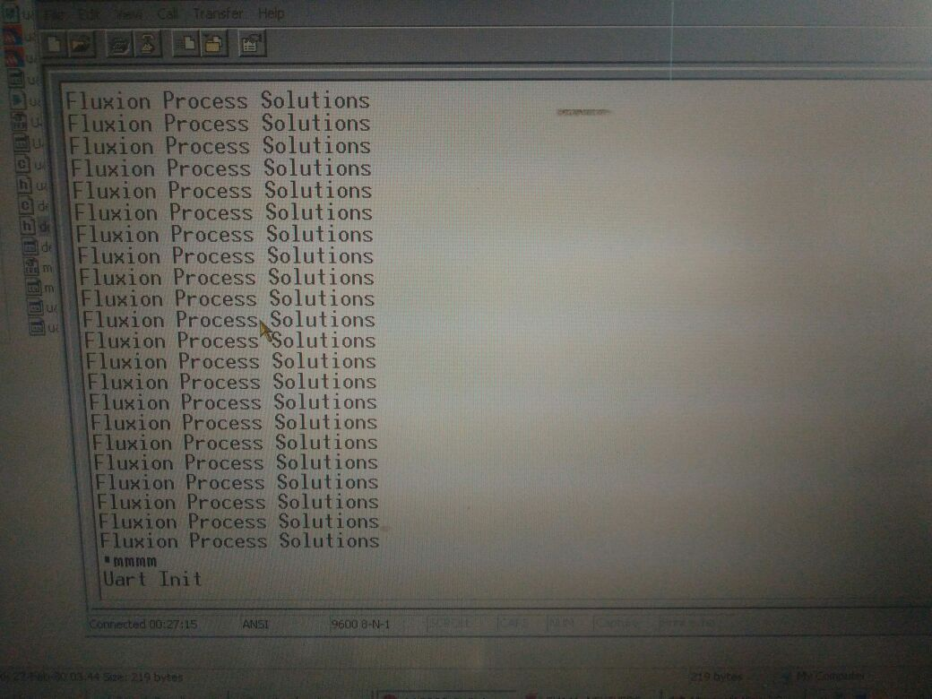
RESULTS
UART INITIALIZE

Slide 30
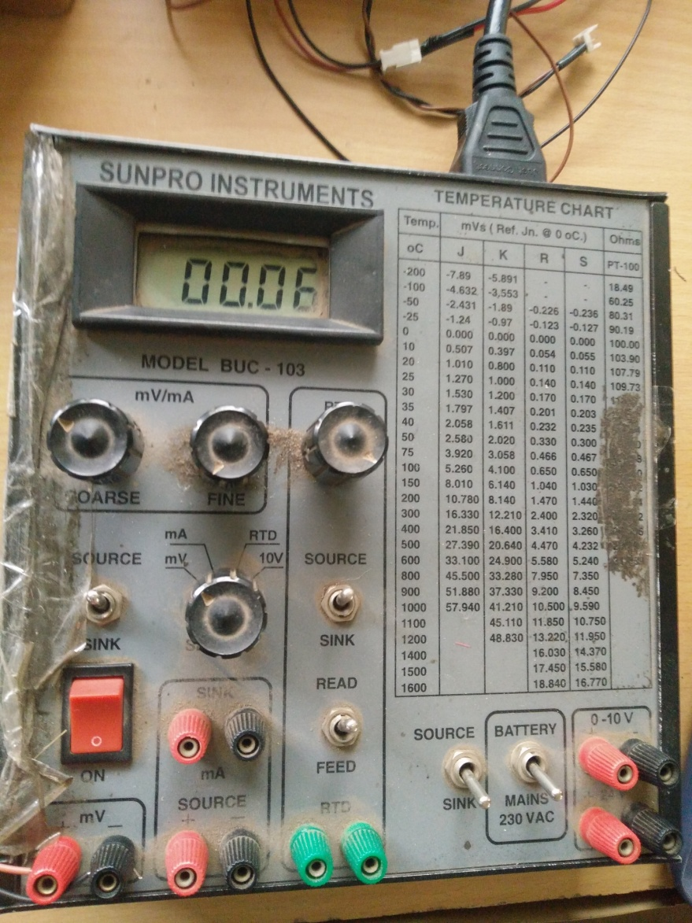
ADC TESTING for minimum count

Slide 31
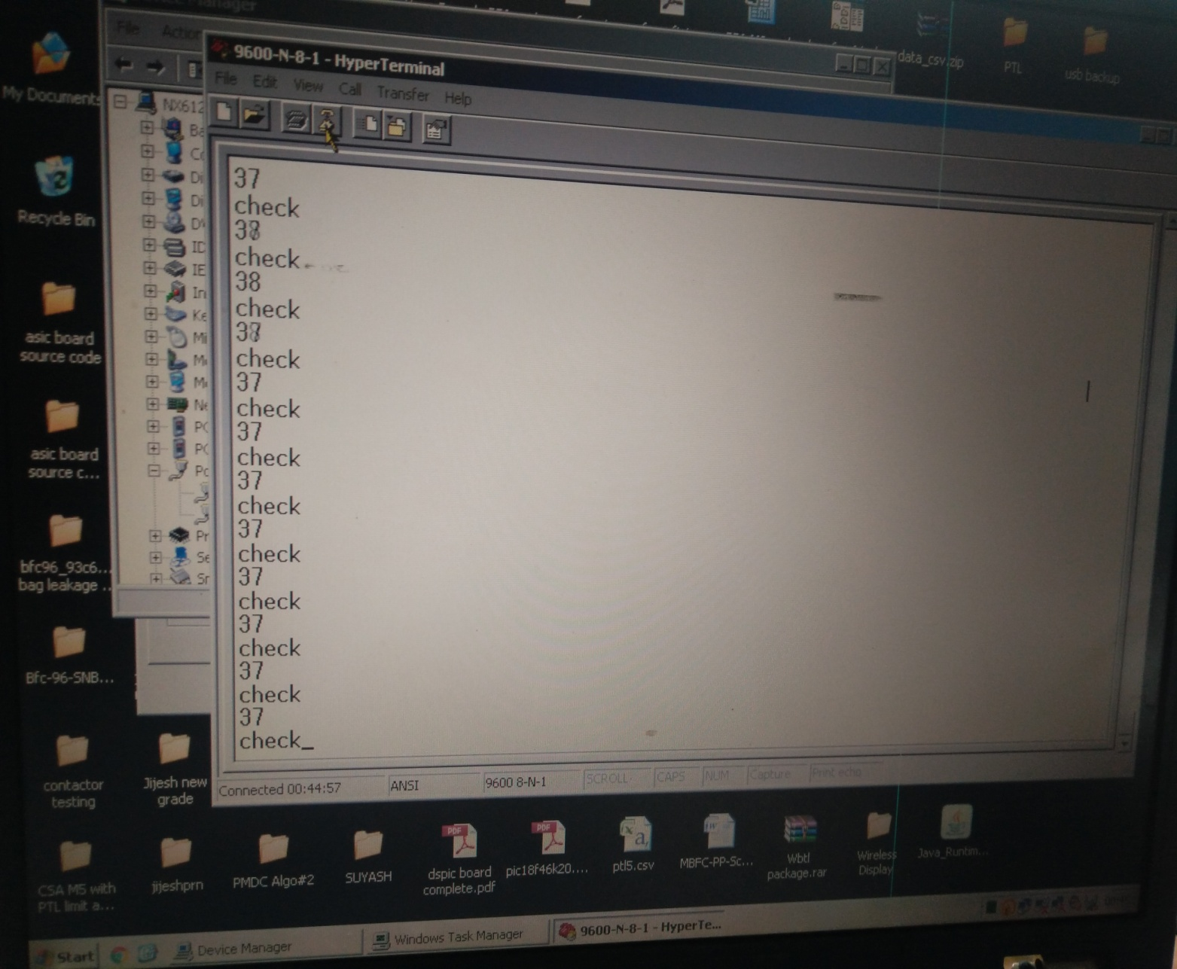
Output on uart

Slide 32
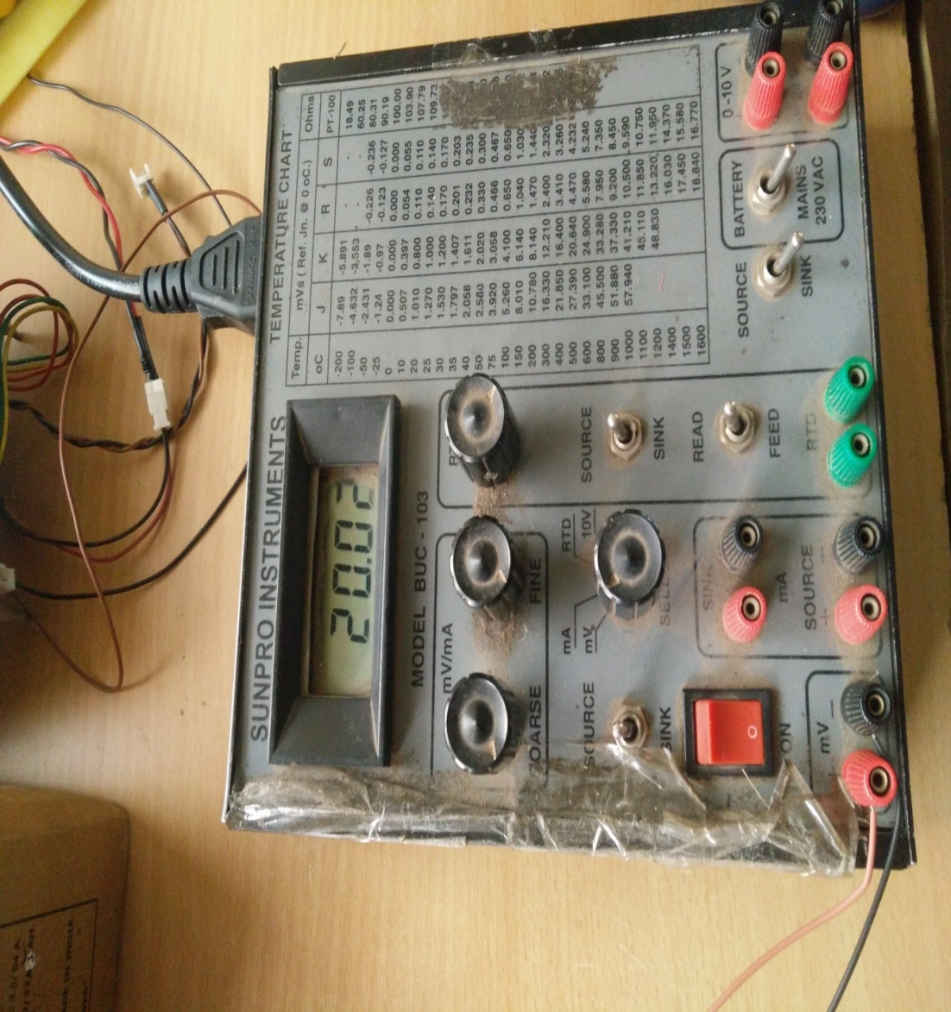
ADC TESTING for maximum count

Slide 33
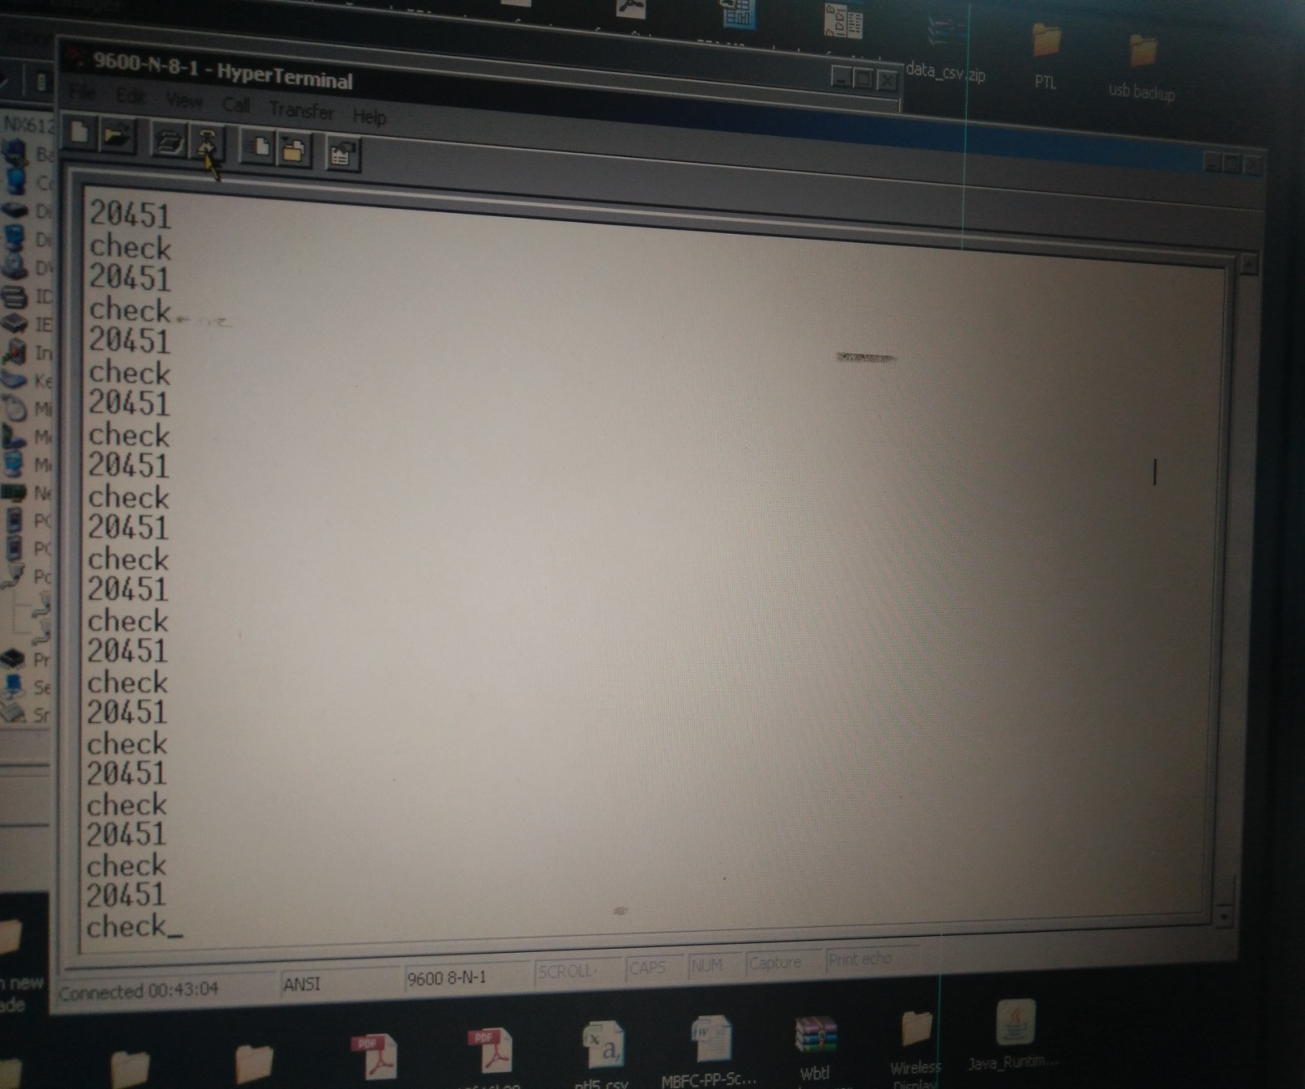
Output on uart

Slide 34
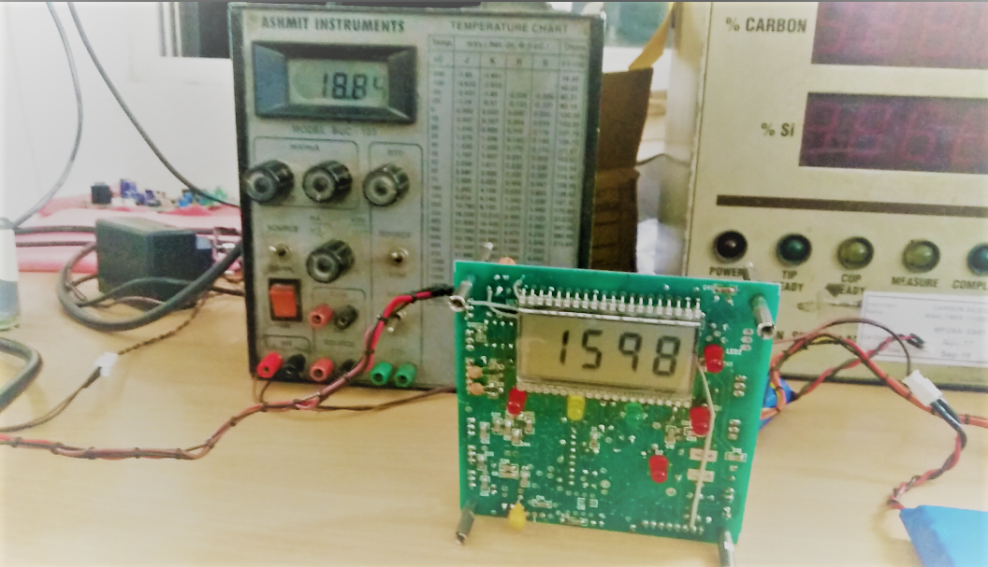
Lcd output

Slide 35
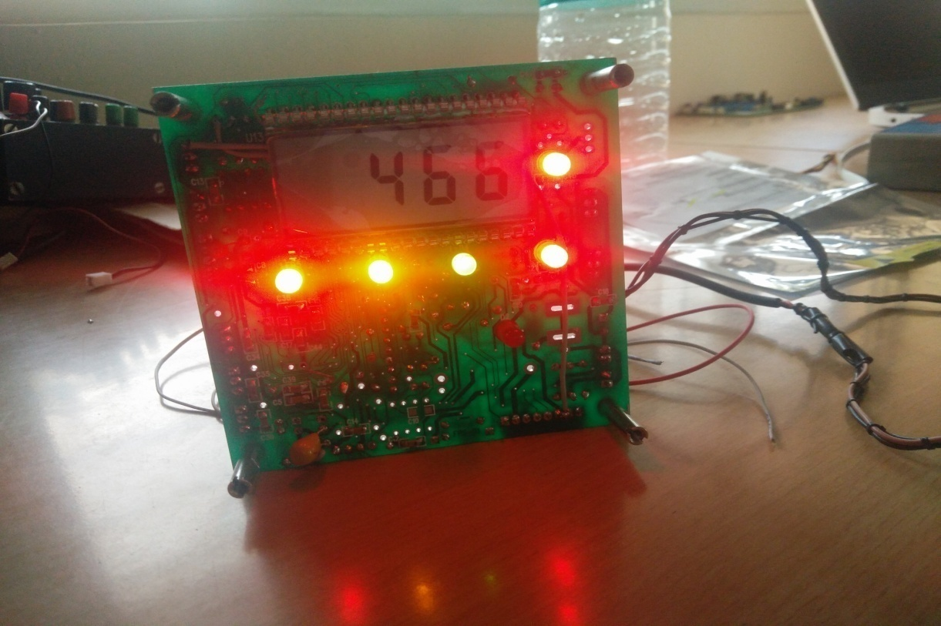
LED INDICATOR OUTPUT

Slide 36
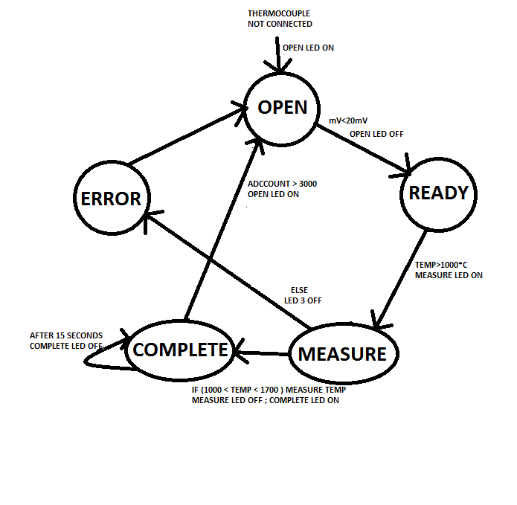
Led indicator state diagram

Slide 37
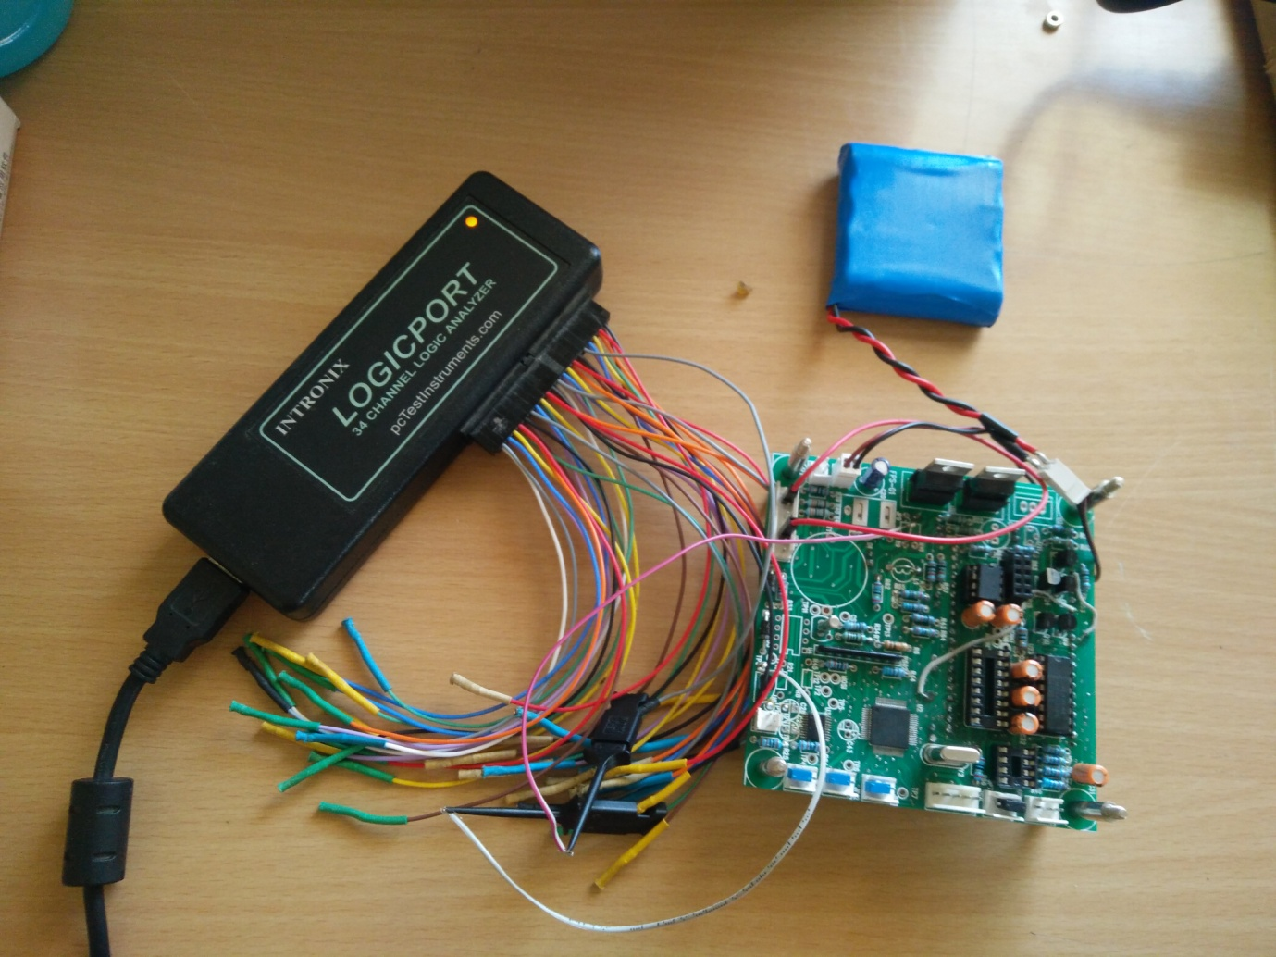
Logic analyzer

Slide 38
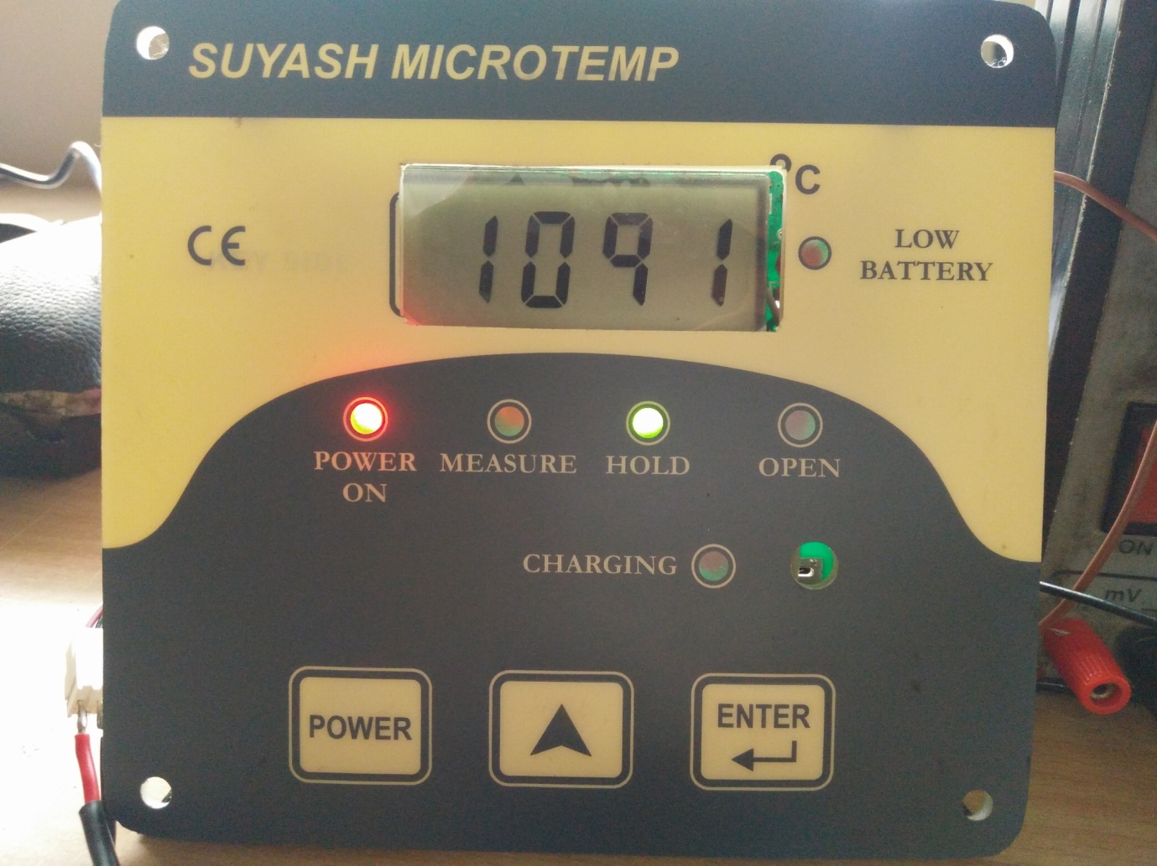
Final product

Slide 39

demo

Slide 40
conclusion
We have gained insight about the various parameters associated with a pyrometer.
We learned the importance of meticulous research required to select a particular component.
We learned various software tools.
We got an opportunity to learn the steps used to design a product at an industrial level.

Slide 41
FUTURE SCOPE
Foundry/Furnace: We can use this system in industries where metals are melted at high temperature.
Evolve the current wireless pyrometer to a wireless ADC system. It will be more compact and easier to handle
Explore the project domain from the point of view of Intelligent Systems.
We can make a closed loop system which automatically adjusts the temperature of the furnace with the help of an intelligent machine and Internet of Things.

Slide 42
REFERENCES
http://www.microchip.com/ParamChartSearch/chart.aspx?branchID=107- Microcontroller selection
http://www.pyromation.com/Downloads/Data/emfr_c.pdf- Thermocouple R-type- thermoelectric voltages as a function of temperature chart.
http://ww1.microchip.com/downloads/en/devicedoc/39666f.pdf- AN658 LCD Fundamentals and the LCD Driver Module of 8-Bit PIC MCUs.
http://ww1.microchip.com/downloads/en/AppNotes/01488A.pdf- Bit Banging
https://www.testequity.com/documents/pdf/applications/wi-fi-module-an.pdf- Wi-Fi module selection guide.

Slide 43
THANK YOU

